Slide 1
Exception Handling

Slide 2

Errors in JavaScript
Introduction
Error Handling Using try and catch
finally
Developer Defined Errors

Slide 3
Errors in JavaScript

Slide 4
Errors in JavaScript
let car = newCar;
console.log('continuing...');

Slide 5
Error Handling Using try and catch

Slide 6
try and catch
try {
let car = newCar;
}
catch(error) { console.log('error: ', error);
}
console.log('continuing...');

Slide 7
finally

Slide 8
try, catch, finally
try {
let car = newCar;
}
catch(error) { console.log('error: ', error);
}
finally {
console.log('this always executes');
}

Slide 9
Developer Defined Errors

Slide 10
throw
try {
// code here...
throw new Error('my custom error');
}
catch(error) { console.log('error: ', error);
}
finally {
console.log('this always executes');
}

Slide 11
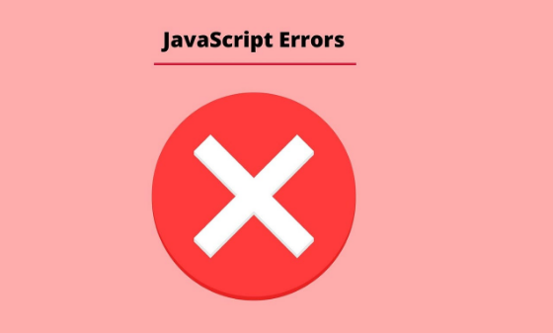
Reference: http://help.dottoro.com/ljfhismo.php

Slide 12
Errors in JavaScript
Stop execution?
Error Handling Using try and catch
catch executes on an exception
finally
always executes
Developer Defined Errors
throw
Error Object
Properties
Methods
Summary

